Slide 1
Restaurant Location Selection in New York City
By Dominic Fiorentino

Slide 2
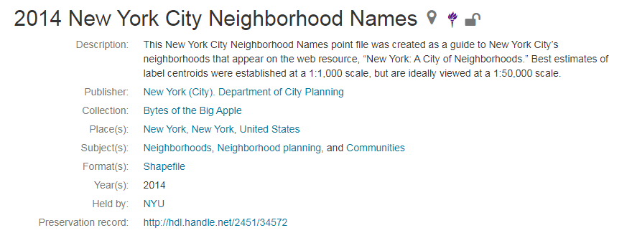
Utilizing NYU New York City Data Set

Slide 3
Utilizing the Foursquare API and merging venue information into the data set

Slide 4
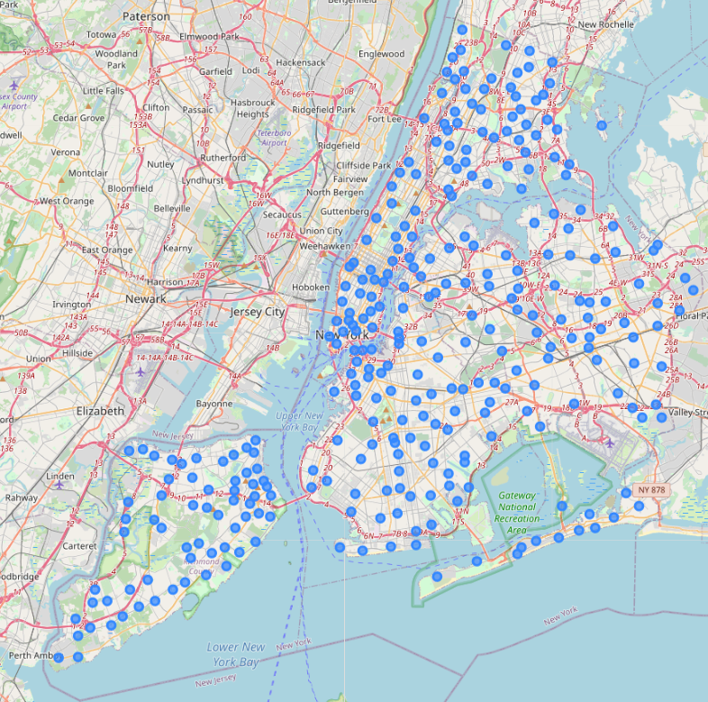
Map of the Neighborhoods of New York City
Each Dot represents a centroid of the corresponding Neighborhood

Slide 5
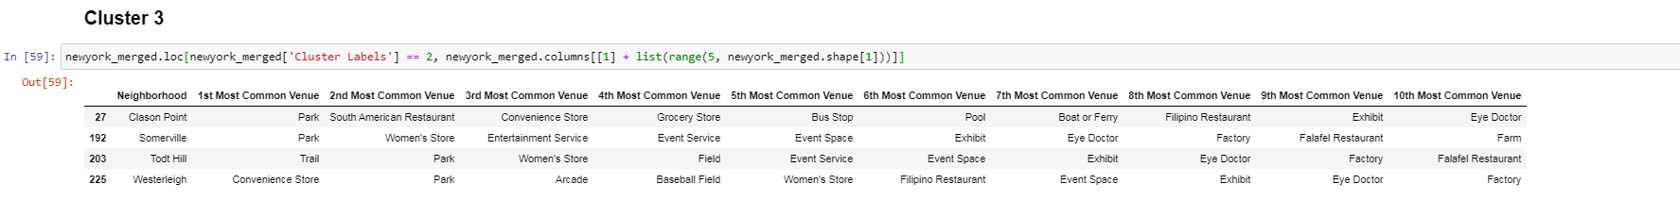
Clustering Neighborhoods

Slide 6
Potential Location
The potential location identified through data analysis and clustering identified Brookville, NY as a desired location for a new restaurant.

Slide 7
Rationale for selection of Brookville
Only having 2 out of ten common venues being food
Increased revenue opportunities of partnering with the event and exhibit spaces for catering of events
The proximity to farms which is listed as the 10th most common venue allows for an increased potential savings on food while also being able to advertise as local farm to table restaurant in New York City.

